Slide 1
Bootstrapping

Slide 2
Outline
Basic concepts
Case study

Slide 3
Motivation
What’s the average price of house prices?
From F, get a sample x=(x1, x2, …, xn), and calculate the average u.
Question: how reliable is u? What’s the standard error of u? what’s the confidence interval?

Slide 4
Solutions
One possibility: get several samples from F.
Problem: it is impossible (or too expensive) to get multiple samples.
Solution: bootstrapping

Slide 5

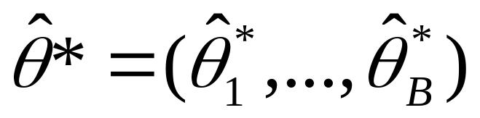
Procedure for bootstrapping
Let the original sample be x=(x₁,x₂,…,x_{n})
Repeat B times
  Generate a sample x* of size n from x by sampling with replacement.
  Compute for x*.
➔ Now we end up with bootstrap values
Use these values for calculating alll the quantities of interest (e.g., standard deviation, confidence intervals)

Slide 6
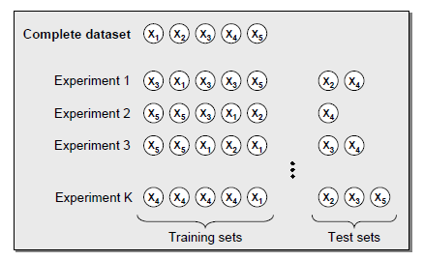

Slide 7
An example
X1=(1.57,0.22,19.67,
0,0.22,3.12)
Mean=4.13
X=(3.12, 0, 1.57,
19.67, 0.22, 2.20)
X2=(0, 2.20, 2.20,
2.20, 19.67, 1.57)
Mean=4.46
Mean=4.64
X3=(0.22, 3.12,1.57,
3.12, 2.20, 0.22)
Mean=1.74

Slide 8
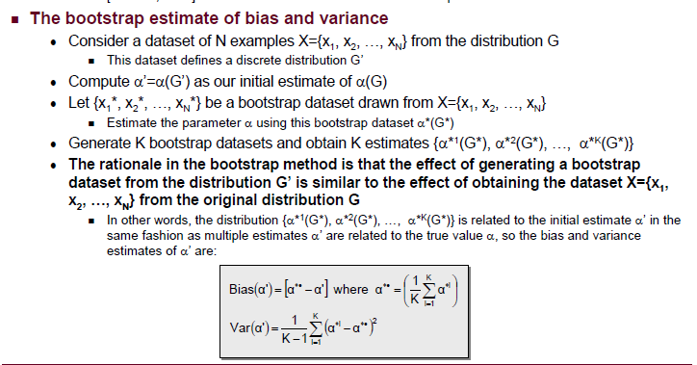

Slide 9
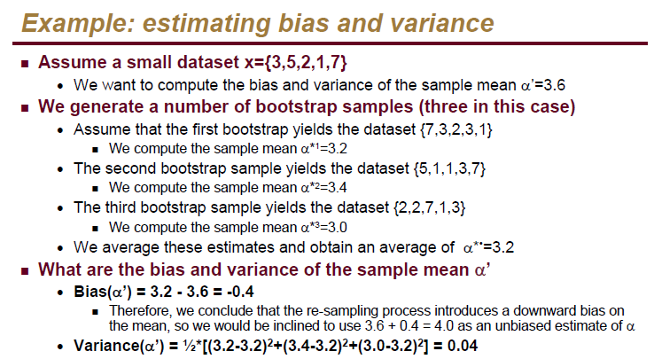

Slide 10
A quick view of bootstrapping
Introduced by Bradley Efron in 1979
Named from the phrase “to pull oneself up by one’s bootstraps”, which is widely believed to come from “the Adventures of Baron Munchausen”.
Popularized in 1980s due to the introduction of computers in statistical practice.
It has a strong mathematical background.
While it is a method for improving estimators, it is well known as a method for estimating standard errors, bias, and constructing confidence intervals for parameters.

Slide 11
A quick view of bootstrap (cont)
It has minimum assumptions. It is merely based on the assumption that the sample is a good representation of the unknown population.
In practice, it is computationally demanding, but the progress on computer speed makes it easily available in everyday practice.

Slide 12
The population ➔ population distribution (unknown)
Original sample ➔ sampling distribution ?
Resamples ➔ bootstrap distribution

Slide 13
Bootstrap distribution
The bootstrap does not replace or add to the original data.
We use bootstrap distribution as a way to estimate the variation in a statistic based on the original data.

Slide 14
Bootstrap distributions usually approximate the shape, spread, and bias of the actual sampling distribution.
Bootstrap distributions are centered at the value of the statistic from the original data plus any bias, while the sampling distribution is centered at the value of the parameter in the population, plus any bias.

Slide 15
Cases where bootstrap does not apply
Small data sets: the original sample is not a good approximation of the population
Dirty data: outliers add variability in our estimates.
Dependence structures (e.g., time series, spatial problems): Bootstrap is based on the assumption of independence.

Slide 16
How many bootstrap samples are needed?
Choice of B depends on
Computer availability
Type of the problem: standard errors, confidence intervals, …
Complexity of the problem

Slide 17
Why resampling?
Fewer assumptions
  Ex: resampling methods do not require that distributions be Normal or that sample sizes be large
Greater accuracy: Permutation tests and some bootstrap methods are more accurate in practice than classical methods
Generality: Resampling methods are remarkably similar for a wide range of statistics and do not require new formulas for every statististic.
Promote understanding: Boostrap procedures build intuition by providing concrete analogies to theoretical concepts.

